Slide 1

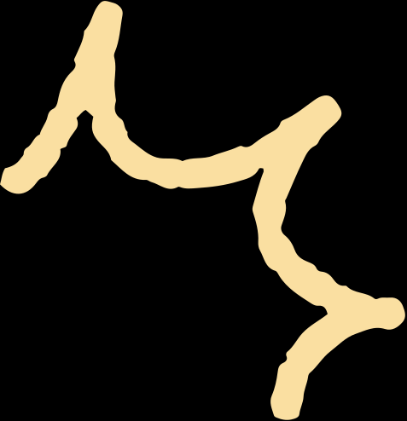
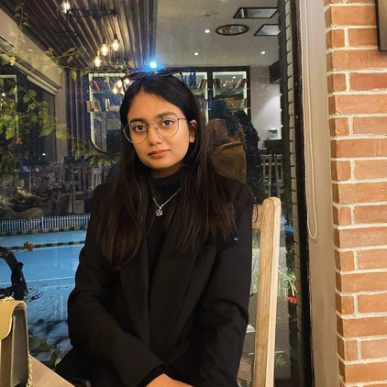
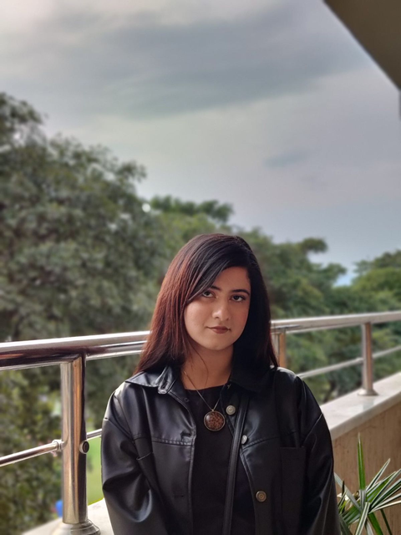
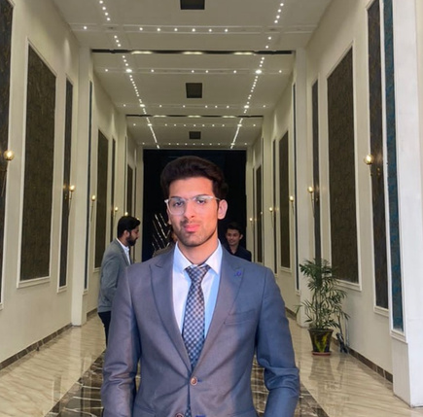

A16
DESIGN MINDS
Momina Ali
21i-2521
Amina Rafi
21i-0742
Ali Mansoor
21i-0593

Slide 2

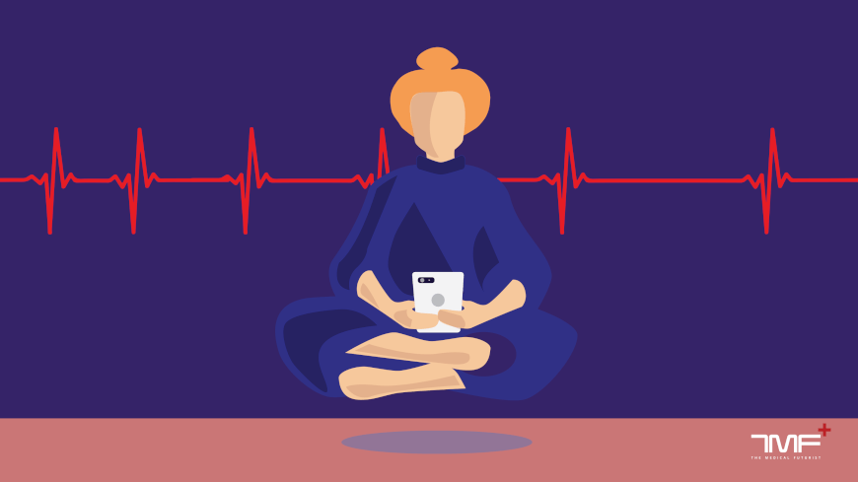


DESIGN CHALLENGE 1 STATEMENT
How can technology help individuals express their emotions in a creative and engaging way without relying on text-based journaling?

Slide 3
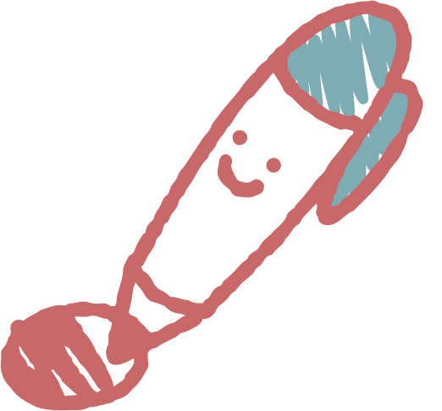
MOOD MOSAIC
Mental Health / Self-Expression
"Express your emotions through art! Mood Mosaic lets you track your feelings with colors, turning your mood into a visual masterpiece.
#MentalHealth #CreativeJournaling"
Needs
Ranking
Metric
Score
Creative Mood Expression
Drag-and-Drop Mood Mosaics
Emotional Trends Visualization
Anonymous Sharing & Community Support
Must Have
Impact
Feasibility
Scalability
Engagement
9
8
7
9
Must Have
Nice to Have
Optional
Total Score: 33/40
Page | 09

Slide 4
DESIGN CHALLENGE 2 STATEMENT
How can technology make gratitude journaling more interactive and engaging for users who find traditional methods too passive?

Slide 5
GRATIMATE
Gratitude & Self-Reflection
"AI-powered gratitude journaling! 📝✨ GratiMate helps you track happiness trends, offers mood-based prompts, and encourages positivity.
#SelfGrowth #AIJournaling"
Needs
Ranking
Metric
Score
AI-Powered Insights
Mood-Based Gratitude Prompts
Voice Log for Journaling
Selective Sharing for Motivation
Must Have
Impact
Feasibility
Scalability
Engagement
8
9
8
8
Must Have
Nice to Have
Optional
Total Score: 33/40
Page | 09

Slide 6
DESIGN CHALLENGE 3 STATEMENT
How can technology encourage small acts of kindness and reinforce positive behavior through gamification?

Slide 7
DAILY SMILE
Kindness & Well-being
“One small act of kindness a day can change the world! 🌍✨ Daily Smile gamifies kindness, helping you track and share your impact.
#KindnessMatters #DailySmileApp
Needs
Ranking
Metric
Score
Daily Kindness Challenge
Smile Tracker to Log Actions
Inspirational Quotes & Stories
Shareable Kindness Reports
Must Have
Impact
Feasibility
Scalability
Engagement
9
7
8
9
Must Have
Nice to Have
Optional
Total Score: 33/40
Page | 09

Slide 8


THANK YOU

